Slide 1






Properties of Carbon-Oxygen White Dwarfs From Monte Carlo Stellar Models
Carl Edward Fields, Jr.
ASU/NASA Space Grant
School of earth & space exploration
Joint Institute for Nuclear Astrophysics
April 16, 2016
Fields et al. 2016, ApJ, In Press; Arxiv: 1603.06666

Slide 2
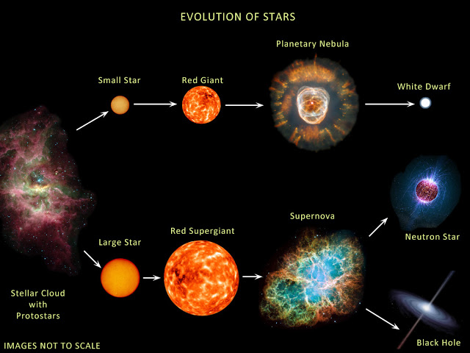
Introduction
The Problem: Nuclear reaction rates are uncertain at astrophysical energies and can affect the properties of White Dwarfs (WDs).
Our study: quantify the effect of composite uncertainties in the nuclear reaction rates.
Our instrument: 1D stellar evolution code, Modules for Experiments in Stellar Astrophysics, MESA and STARLIB nuclear reaction rate library.

Slide 3
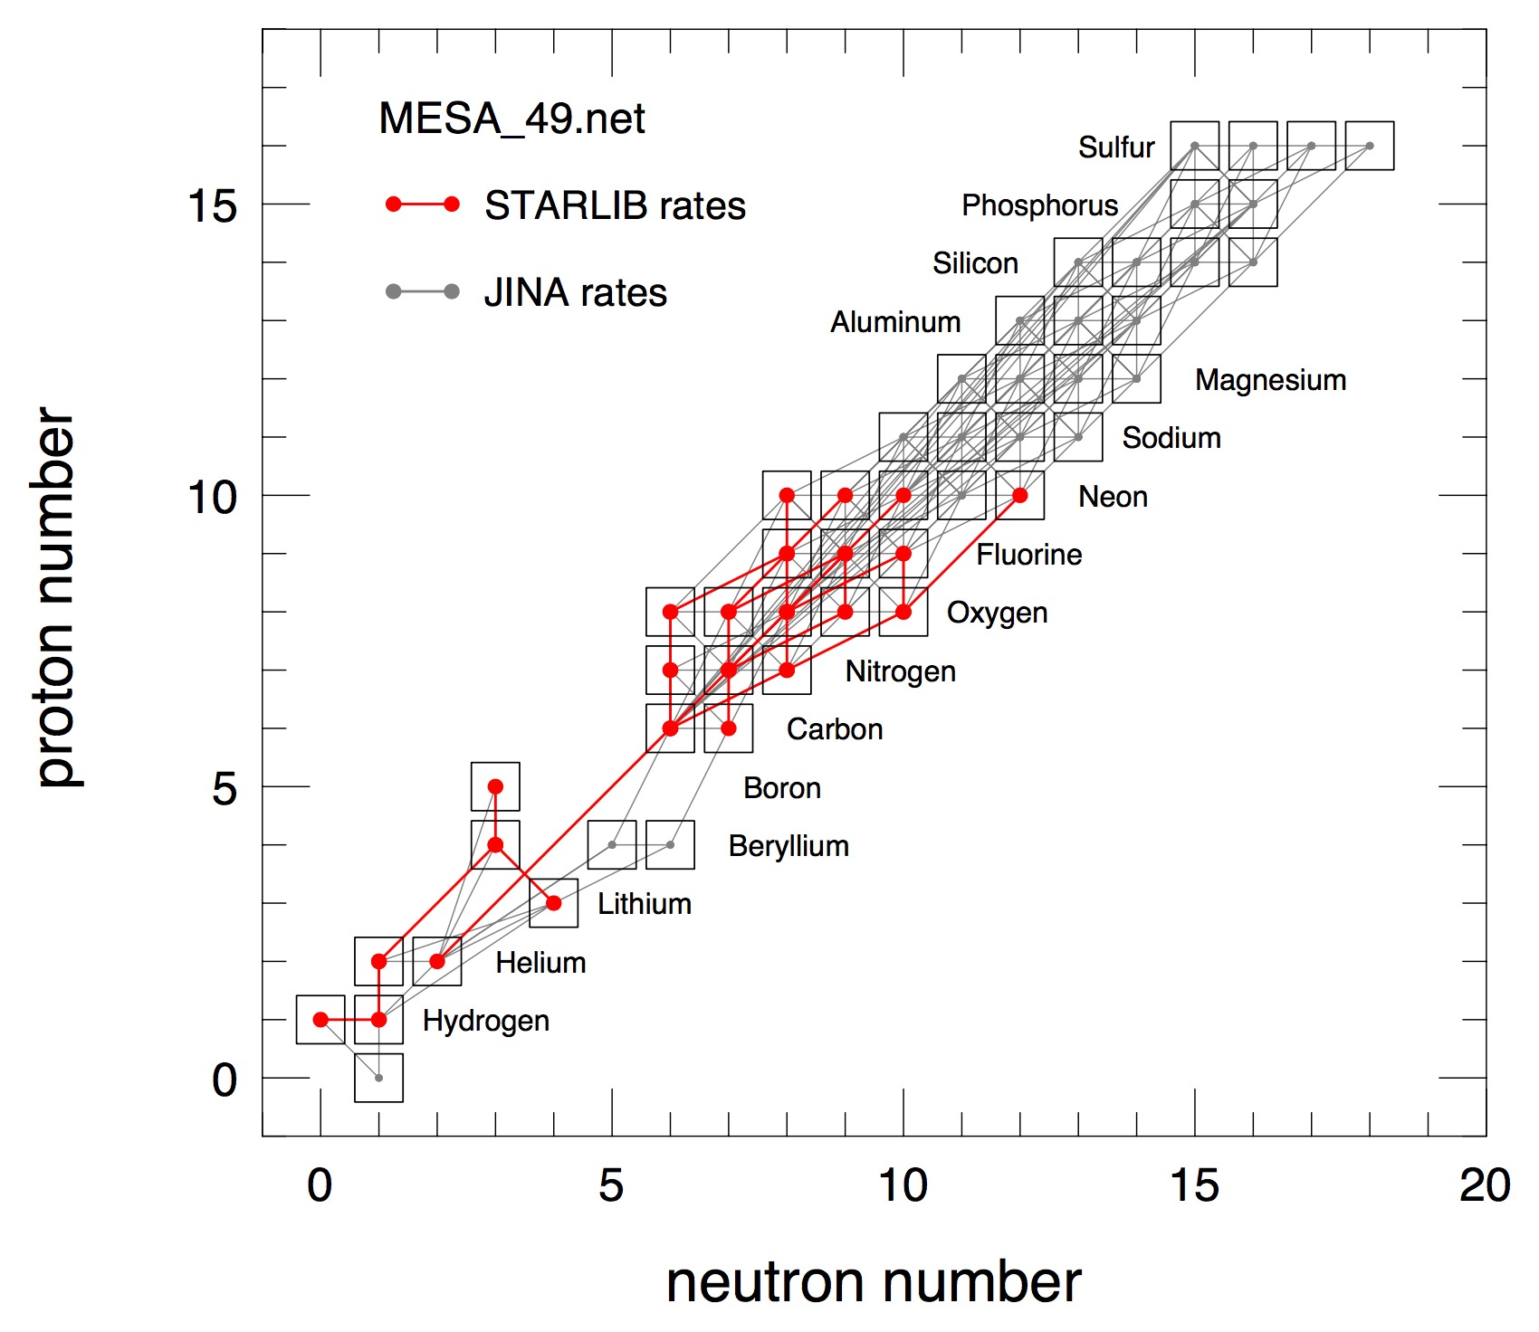
Methods - Key Reactions
We use the input physics described in Farmer, Fields, & Timmes, 2015, ApJ, 807,184.
We focus on 26 key H and He burning reactions using STARLIB (Sallaska + 2013).
STARLIB allows for reaction rate sampling within experimental uncertainties.
FIG. 1 - The mesa_49.net reaction network used to quantify the variance of CO WD properties. Reactions that use the STARLIB probability functions are shown in red while reactions that use the JINA reaclib are shown in gray.

Slide 4
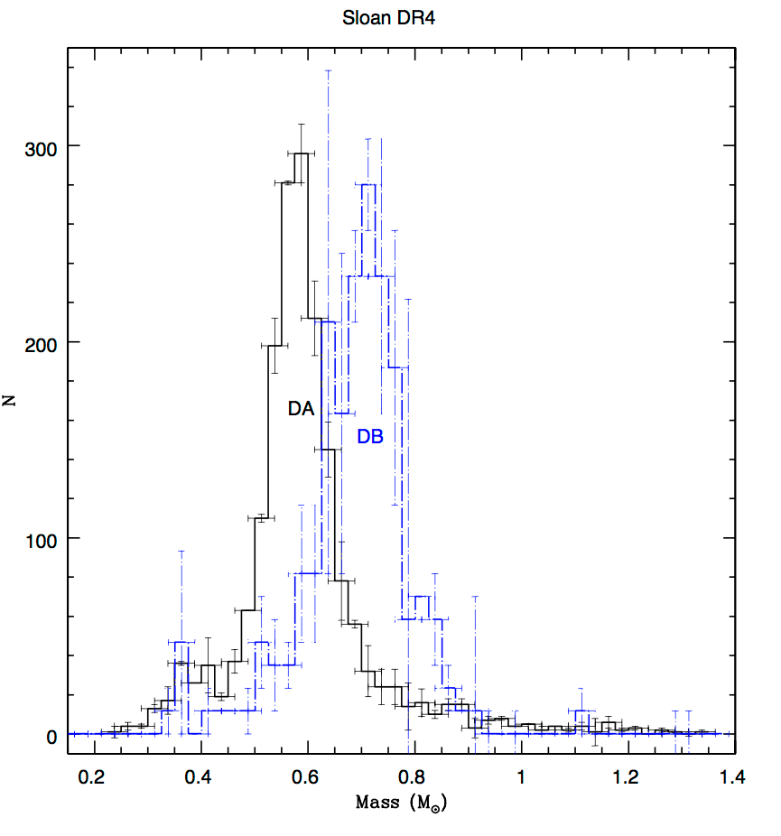
Methods - our grid
We perform the first Monte Carlo stellar evolution studies using complete stellar models.
We focus on a 3 M⊙ star evolved from the pre main-sequence to the first thermal pulse.
We evolve a grid of j = 1,000 Monte Carlo stellar models sampling 26 rates.
FIG. 3 - DA and DB white dwarf histogram from SDSS Data Release 4. From Kepler et al. 2007.

Slide 5
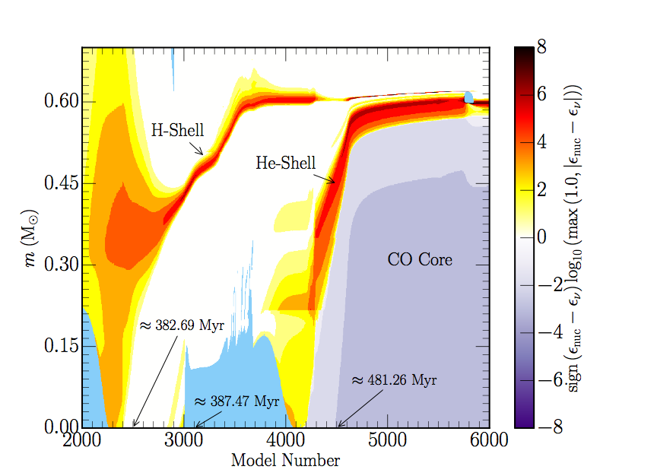
Results - Baseline Model
Baseline 3 M⊙ model reaches first thermal pulse at ~ 483 Myr to form a ~ 0.59 M⊙ WD.
Computation takes ~24hrs on 1 core.
FIG. 4 - Kippenhahn diagram of the baseline 3 M⊙ model from the MS to formation of a ≈ 0.645 M⊙ WD.

Slide 6
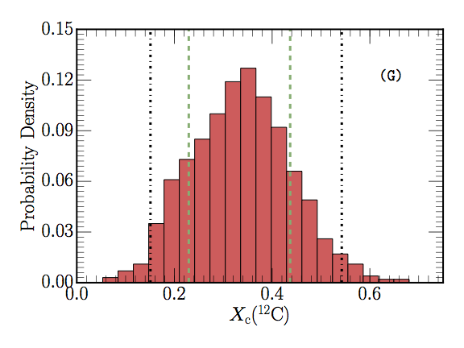
Results - Monte Carlo stellar models
The central ^12C mass fraction varies from +/- 0.24. This represents a ~116% variation using the 95th percent confidence interval and ~ 62% variation for central O16.
Other properties considered have less than ~4% variation.
FIG. 5 - Histogram of the central X(^12C) mass fraction for 1,000 3 M⊙ Monte Carlo stellar models sampling 26 nuclear reactions.

Slide 7
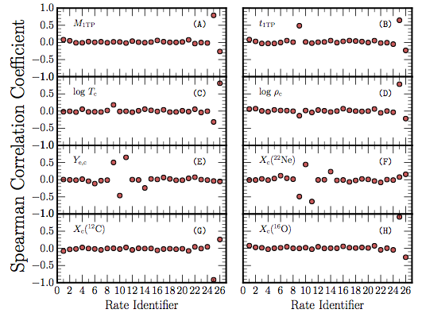
Results - Monte Carlo stellar models
We perform a Spearman’s Rank-Order Correlation to identify the most influential reactions.
We find that most influential reactions are the ¹²C(α, γ)¹⁶O, triple-α, and ¹⁴N(p, γ)¹⁵O reactions.
What is the impact of the uncertainties in the nuclear reaction rates on the Initial- Final Mass Relation (IFMR)?
FIG. 7 - Spearman rank correlation coefficients for the 26 independently sampled nuclear reaction rates for 1,000 Monte Carlo stellar models with a ZAMS mass of 3 M⊙.

Slide 8
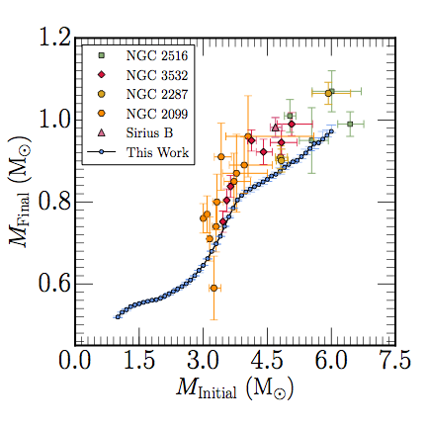
Results - Monte Carlo stellar models
We use the STARLIB low, med, and high rates for 1 - 6 M⊙ in steps of 0.1 M⊙ and evolve from pre-MS to final WD.
The final WD masses using each set of reactions agree to within ≈ ± 0.003 M⊙.
Mean trend is found to lie below the data. Differences attributed to choices in convective overshoot efficiency.
FIG. 11 - IFMR of 153 stellar models evolved from the pre-MS to the final WD stage.

Slide 9
Conclusions
The uncertainties in the ¹²C(α, γ)¹⁶O, triple-α, and ¹⁴N(p, γ)¹⁵O, and ¹⁵N(p,γ)¹⁶O reactions dominate the variations.
The largest variations are found for the central ¹²C and central ¹⁶O mass fractions.
The IFMR is well constrained to ≈ ± 0.003 M⊙ within the experimental uncertainties associated with 26 key H and He burning reactions.
Discrepancies in the mean trend of the IFMR reported here suggests a further assessment of the efficiency of convective overshoot.

Slide 10
Acknowledgments
First and certainly foremost, I thank my advisor Frank Timmes. Thank you for believing in my ability to pursue astrophysics and providing me with the opportunities to be successful.
To my family and friends for supporting me through my journey.
The ASU/NASA Space Grant Staff: Michelle Tanaka, Candace Jackson, and Desiree Crawl.
This project was supported by NASA under the Theoretical and Computational Astrophysics Networks grant NNX14AB53G and the Astrophysics Theory Program grant 14-ATP14-0007, and by NSF under the Software Infrastructure for Sustained Innovation grant 1339600, and grant PHY 08-022648 for the Physics Frontier Center ``Joint Institute for Nuclear Astrophysics - Center for the Evolution of the Elements'' (JINA-CEE). C.E.F. acknowledges support from Arizona State University under a 2015 CLAS Undergraduate Summer Enrichment Award, a 2015-2016 Norm Perrill Origins Project Undergraduate Scholarship, and a ASU/NASA Space Grant award.

